Slide 1
STELLA INSIGHTS MOBILE
Product Handoff:
Flows & States Walkthrough
MVP Phase 1 build · Sign-In & Access, Insights, Alerts, Conversations, Customers, Account
Prepared for leadership review · August 2026

Slide 2
CONTEXT & SCOPE
What this walkthrough covers
1
2
3
It's a working prototype
It is not the shipped app
Six core flows, end to end
Built as real HTML/CSS/JS — not static mockups. Every screenshot in this deck is a live, interactive state of the app, driven from the actual Figma “Sign In,” “Profile,” and “MVP Phase 1” specs.
This is a design/engineering reference build used to validate flows before native iOS/Android implementation. Some actions (Call, voice messages, Privacy & Support) are intentionally stubbed — see the “Known Gaps” slide.
Sign-In & Access, Insights (Service Dashboard), Alerts, Conversations, Customers, and Account & Settings — including every branch, error, and empty state we could exercise.
2

Slide 3
INFORMATION ARCHITECTURE
How the app is put together
A persistent bottom tab bar plus two navigation patterns layered on top — the same model Insights Mobile uses everywhere.
Insights
Conversations
(Voice FAB)
Alerts
Customers
Bottom tab bar — switching tabs resets that tab's own navigation stack (no back-history), matching standard iOS tab behavior.
Pushed screens
Profile & Account, Notifications, Rooftop Access, a Conversation thread, Compose — each slides in with a Back button and its own place in the stack.
Bottom sheets
Account menu, Sign Out confirm, Quick Actions, Date Range, Custom Range, Switch Rooftop — modal overlays that don't touch the navigation stack; a backdrop tap or grabber dismisses them.
In-app browser sheet
The SSO / Okta “provider sheet” during sign-in — visually distinct from the app's own bottom sheets to signal it's a hand-off to the dealership's identity provider.
3

Slide 4
FLOW 1 / 6
Sign-In & Access
Email-first launch, domain-based routing to SSO or a STELLA password, Face ID return visits, and the access-not-provisioned dead end.

Slide 5
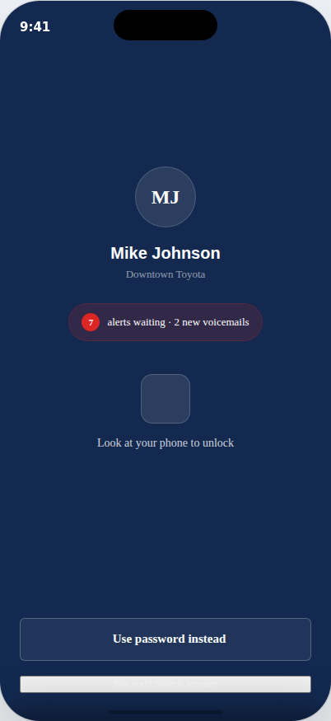
FLOW 1 · SIGN-IN
Returning users: Face ID unlock
95% of launches land here.
The app opens straight to Face ID for a signed-in device — no email, no password.
Shows who's signed in, the current rooftop, and a live count of waiting alerts — useful context before you're even in.
Auto-unlocks after ~1.8s to simulate the OS Face ID prompt; tapping the scan tile unlocks immediately.
“Use password instead” and “Switch account” both drop back to the email-first Launch screen.
5

Slide 6
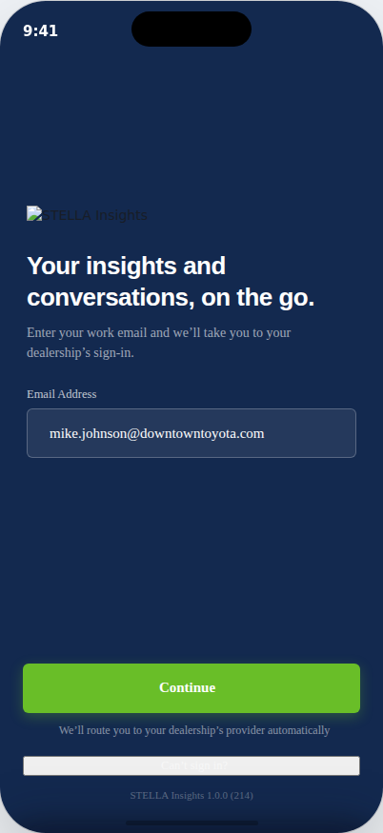
FLOW 1 · SIGN-IN
First-time / signed-out: email-first Launch
One field. No upfront SSO-vs-password choice.
The user just enters their work email — the domain silently decides what happens next.
downtowntoyota.com → routes to the dealership's SSO provider (Okta).
Any other domain → reveals the STELLA password screen in place.
“Can't sign in?” hands off to a STELLA admin contact — there's no self-serve account recovery from this screen.
6

Slide 7
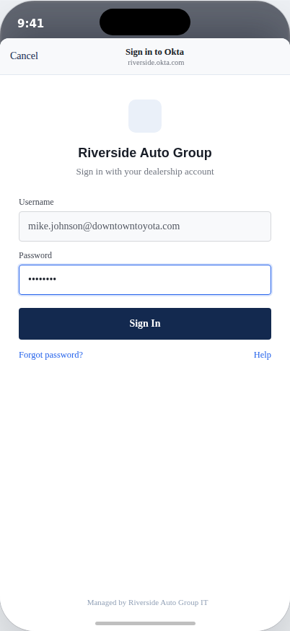
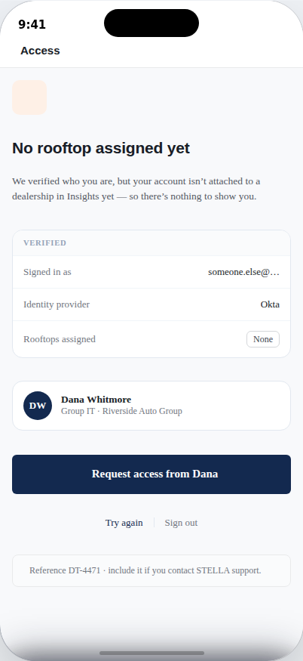
FLOW 1 · SIGN-IN
SSO hand-off: success vs. “not provisioned”
Federated domains open a mocked identity-provider sheet, styled deliberately differently from STELLA's own bottom sheets so it reads as a hand-off.
Signing in there succeeds to Insights for a provisioned account — but if Okta confirms identity while STELLA has no rooftop attached to that user, they land on “No rooftop assigned yet” instead.
That screen shows what was verified, names the group IT contact, and offers “Request access” — no support ticket needed for the most common day-one problem.
In-app Okta sheet
No rooftop assigned
7

Slide 8
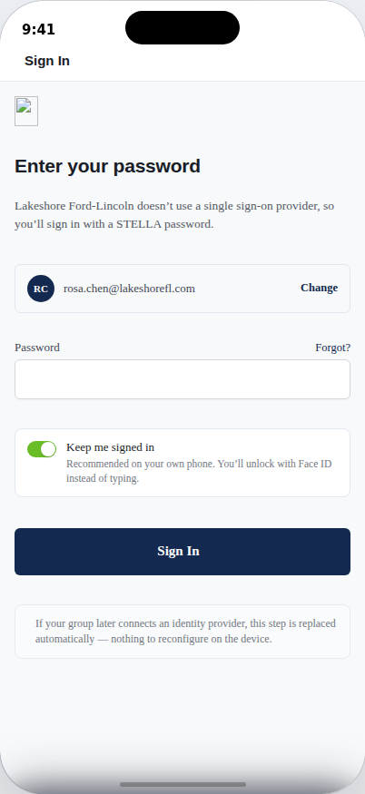
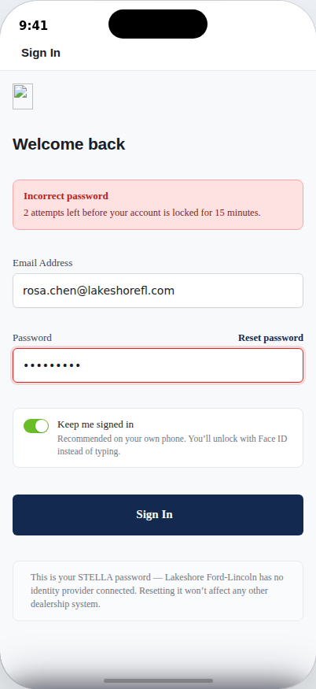
FLOW 1 · SIGN-IN
STELLA password: fresh vs. incorrect
Shown for dealerships without a connected identity provider (no branching UI — the email domain alone decides).
A wrong password swaps the heading to “Welcome back,” shows a live attempts-remaining counter, and outlines the field in red.
The eye icon really toggles visibility. “Forgot?” becomes bold “Reset password” once an error is showing — a small but deliberate nudge toward recovery after a failed attempt.
Fresh attempt
Incorrect password
8

Slide 9
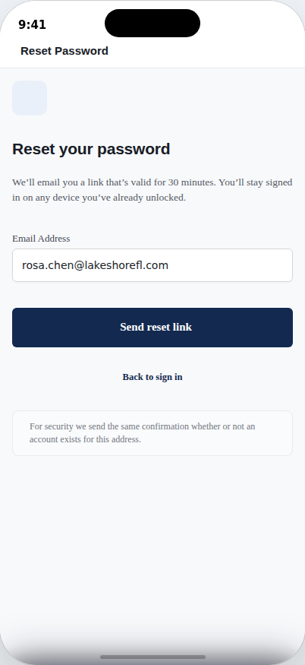
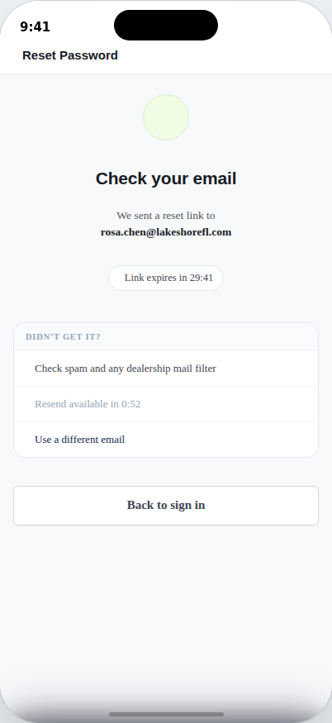
FLOW 1 · SIGN-IN
Password reset: request → sent
Unfederated accounts only (SSO dealerships reset through their own IdP).
The “Check your email” screen runs two live timers: a 30-minute link expiry and a short resend cooldown — both counting down in real time in this build.
For security, the copy says the same confirmation shows whether or not an account exists for that address.
Request reset
Link sent — live countdown
9

Slide 10
FLOW 2 / 6
Insights (Service Dashboard)
The landing tab after sign-in — STELLA's performance summarized for a service manager at a glance.

Slide 11
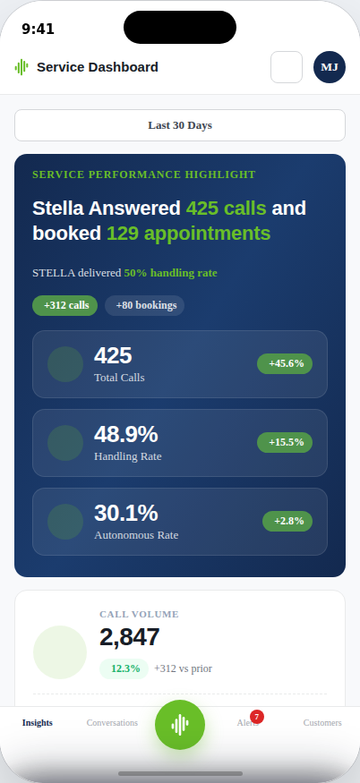
FLOW 2 · INSIGHTS
Service Dashboard — the new landing tab
This is the default screen after every unlock — not Alerts, not Conversations.
Hero card leads with the plain-English headline (“STELLA answered 425 calls and booked 129 appointments”) before any chart.
Three scannable KPIs — Total Calls, Handling Rate, Autonomous Rate — each with a period-over-period delta badge.
Deeper cards below break out Call Volume, Appointments Booked, and Avg Talk Time with progress bars and one-line plain-language captions.
The date-range pill at top drives every number on the screen.
11

Slide 12
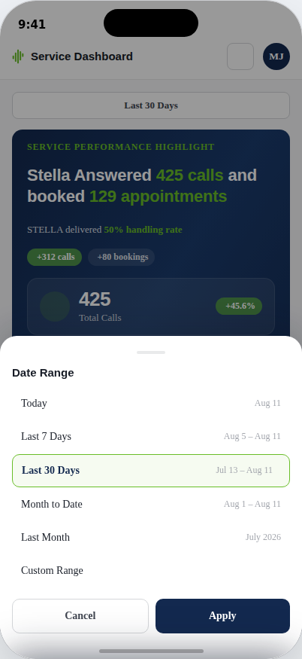
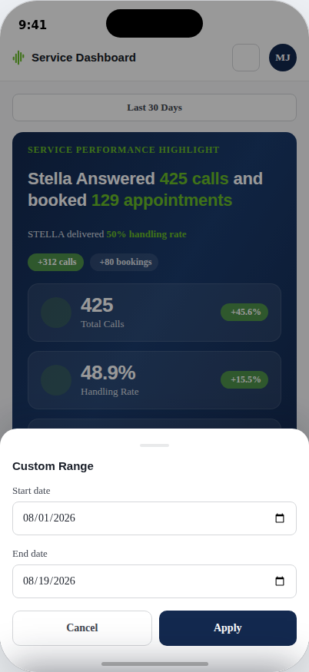
FLOW 2 · INSIGHTS
Date Range — presets and a capped custom picker
Today, Last 7 Days, Last 30 Days, Month to Date, Last Month, or a fully custom range.
Insights itself has no lookback limit — but the same sheet, opened from Alerts, caps Custom Range to the last 30 days and shows an explicit hint why.
That distinction (Insights: unlimited history, Alerts: 30 days) is a real product decision worth confirming is still correct before build.
Date Range presets
Custom Range
12

Slide 13
FLOW 3 / 6
Alerts
Real-time surfacing of the calls that need a human — grouped by day, filterable by type, actionable inline.

Slide 14
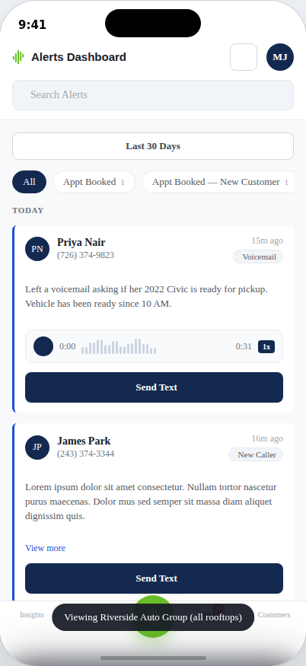
FLOW 3 · ALERTS
Alerts feed — grouped, filtered, actionable
9 alert types: Appt Booked, New Customer, Booking Hangup, Cancelled, Failed Transfer, Low CSAT, New Caller, Recall, Voicemail.
Unread alerts get a left accent bar; each shows time-since, contact, and a type pill.
Voicemail alerts play inline with a real transcript-style waveform and scrub position.
Primary actions are contextual: known contacts get Call + Text; unresolved/no-number alerts fall back to “View more.”
History is capped at 30 days — an end-of-list note tells the user to widen the date range to look further back.
14

Slide 15
FLOW 4 / 6
Conversations
A real SMS-style inbox, one thread per phone number — whether or not that number matches a known customer.

Slide 16
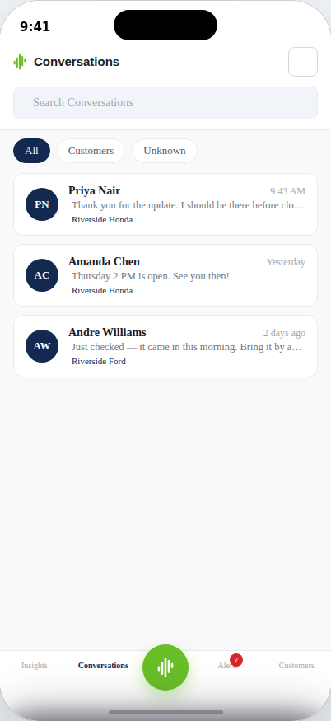
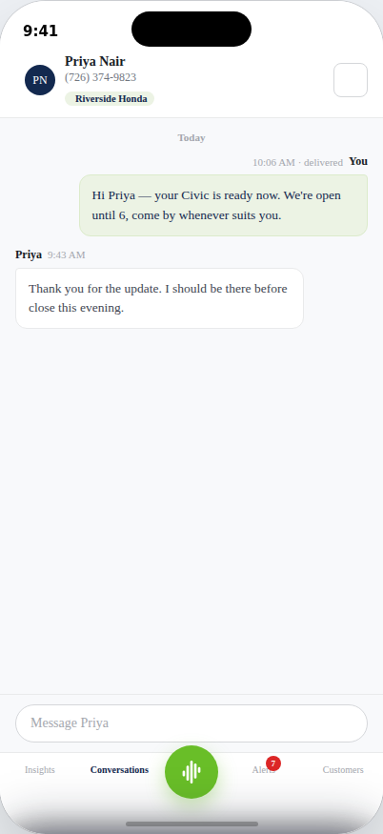
FLOW 4 · CONVERSATIONS
Inbox and thread detail
Sorted most-recent-first; every row previews the last message with a direction indicator (sent vs. received) and a “You:” prefix when it was outbound.
Opening a thread pulls in the customer's name and vehicle automatically when the number matches a record.
When viewing the consolidated “all rooftops” group, each thread also carries a location tag — since a conversation could belong to any rooftop in the group.
Conversations inbox
Thread detail
16

Slide 17
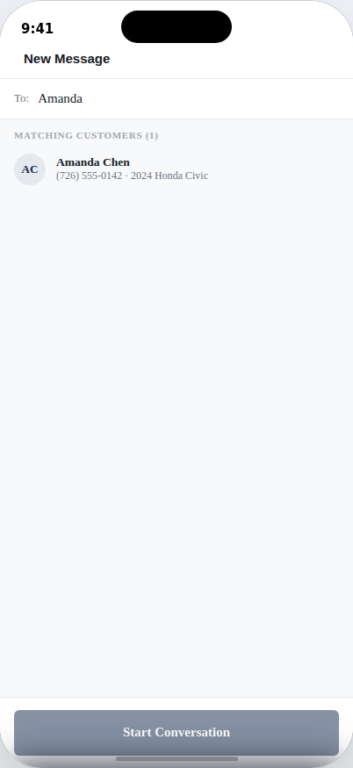
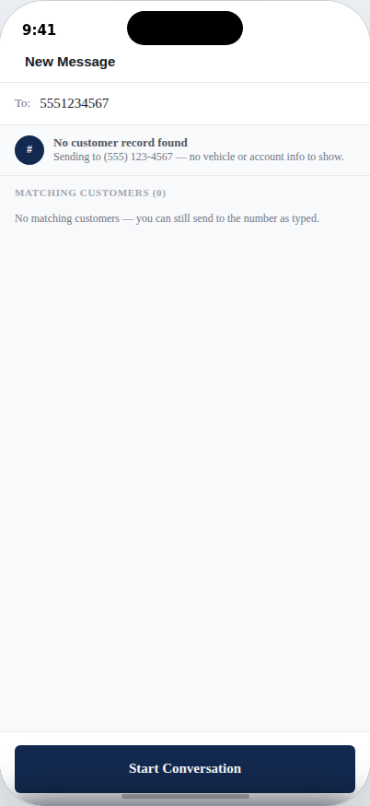
FLOW 4 · CONVERSATIONS
Compose: known customer vs. unknown number
This is a deliberate, explicit design decision — not a gap.
Typing a name searches customer + alert-only contacts live. Typing a phone number checks it against every known record.
A match shows the customer's name, phone, and vehicle in a green confirmation banner before sending.
An unmatched number still lets staff start the thread — clearly labeled “No customer record found” — rather than blocking outreach to someone not yet in the system.
Known customer match
No customer record found
17

Slide 18
FLOW 5 / 6
Customers
The dealership's customer record list — searchable, filterable, and reachable in one tap.

Slide 19
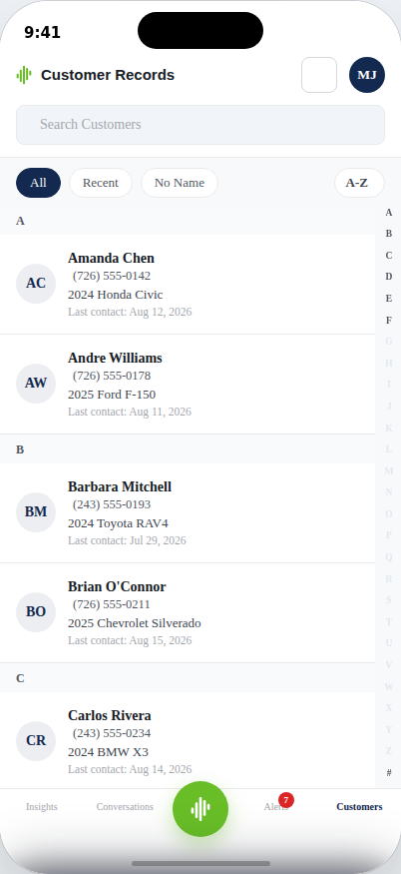
FLOW 5 · CUSTOMERS
Customer Records — search, filter, jump
Grouped alphabetically with a tap-to-jump A–Z sidebar, like a native Contacts app.
Filters: All, Recent (last 5 by contact date), No Name (caller-ID-only records with nothing to alphabetize — grouped under “#”).
Sort toggle flips A–Z / Z–A; unnamed records always sort last regardless of direction.
Tapping any row opens a real conversation thread with vehicle and last-contact context already attached.
The star/“Saved” filter exists in the data model but is intentionally hidden — there's no way to save a customer yet.
19

Slide 20
FLOW 6 / 6
Account & Settings
Identity, notification preferences, and multi-rooftop access — all provisioned by the dealership group's SSO, not self-service.

Slide 21
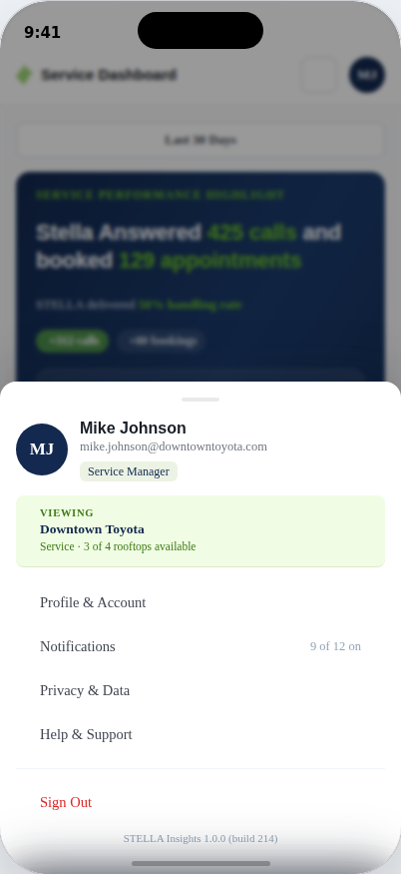
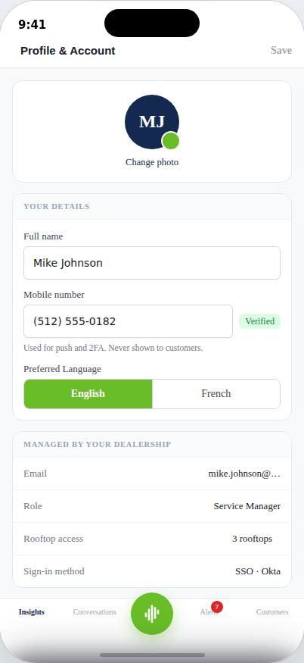
FLOW 6 · ACCOUNT
Account sheet and Profile & Account
The avatar in the top bar opens a bottom sheet with identity, the current rooftop, and links to Profile, Notifications, Privacy, and Support.
Profile lets staff edit their own name, phone, and photo (photo upload works locally in this build) and toggle Face ID and Preferred Language.
Everything under “Managed by your dealership” — email, role, rooftop access, sign-in method — is locked and provisioned centrally, not editable here.
Account sheet
Profile & Account
21

Slide 22
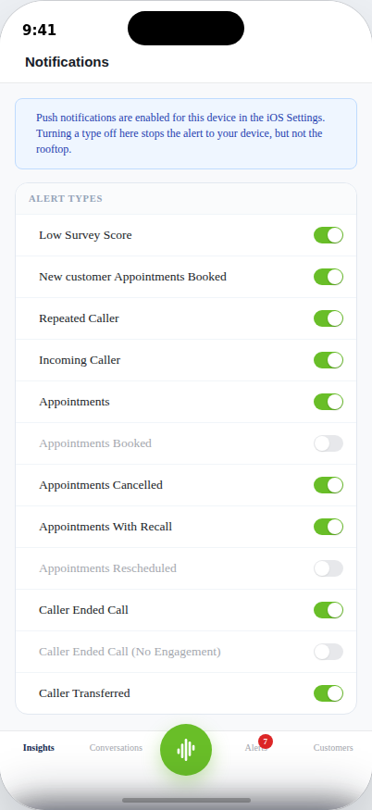
FLOW 6 · ACCOUNT
Notifications — 12 alert types, granular control
Matches the full Figma alert-types list — each with its own icon (star, repeat, phone-transfer, etc.), not one generic bell.
3 of the 12 are permanently greyed out: Appointments Booked, Appointments Rescheduled, Caller Ended Call (No Engagement).
Those three are “not configured for this rooftop” — a dealer-level capability gap, not a bug, but worth a tooltip so it doesn't read as broken.
Every switch here is fully stateful across the session.
Quiet Hours and notification Scope were both removed from this pass — flag if leadership still wants them for launch.
22

Slide 23
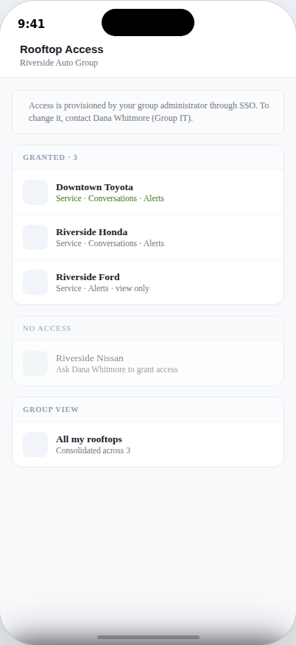
FLOW 6 · ACCOUNT
Rooftop Access & multi-rooftop switching
Staff can be granted access to multiple rooftops within a group (here: 3 of 4 in Riverside Auto Group).
Access itself is read-only in this screen — changes route to the group's IT admin, not a self-service toggle.
The building icon on Insights, Alerts, and Customers opens a live “Switch Rooftop” sheet, including a consolidated “all rooftops” group view.
Switching rooftops updates state everywhere at once — Face ID screen, account sheet, conversation location tags — in this build.
23

Slide 24
CROSS-CUTTING PATTERNS
Patterns that repeat across every flow
Search + filter pills
Empty states
Alerts, Conversations, and Customers all use the same pattern: a search box plus horizontally-scrolling filter pills, applied live with no “apply” step.
“No conversations yet,” “No customers found,” “No messages with this number yet” — every list has a designed empty state, not a blank screen.
Toasts for stubbed actions
Live, stateful controls
Anything not fully built (Call, voice messages, Privacy & Support, Session management) responds with a toast instead of failing silently — keeps the flow honest during review.
Countdown timers, attempt counters, switches, sort toggles, and rooftop context all persist and update in real time within a session — this isn't a click-through mock.
24

Slide 25
FOR THE DEV TEAM
Known gaps & stubbed behavior in this build
Not bugs — deliberate placeholders in a design/flow prototype. Each needs a real decision before native build.
Area | Current behavior | What's needed
Alerts — “Call” button | Shows a toast (“Calling…”) instead of placing a real call. | Needs telephony integration decision (native dialer vs. in-app VoIP).
Conversations — voice messages | Mic button shows “coming soon.” | Confirm whether voice notes are in scope for MVP Phase 1 or a later phase.
Keyboard — caps lock, 123/emoji | Mocked iOS keyboard is functional for text entry only; those keys toast. | Non-issue on a real device (native keyboard) — mocked here only because a prototype can't summon the OS one.
Customers — “Saved” / star | Data model and filter logic exist; the UI entry point is hidden. | No design yet for how/where staff would save a customer — needs a decision, not just re-enabling.
Account sheet — Privacy & Data, Help & Support | Both show a toast placeholder. | Content and destination (in-app page vs. external link) still undefined.
Profile — Active sessions | Row shows a toast placeholder. | Session management UI not yet designed.
Rooftop — “All my rooftops” consolidated view | Toast placeholder from the Rooftop Access screen (the Switch Rooftop sheet's group view does work). | Reconcile the two entry points so both lead to the same real experience.
Sign-out confirm sheet | Minor animation glitch: cancelling doesn't fully retract off-screen on a repeat open in this HTML build. | CSS/transition-timing issue specific to this prototype technology — flag for QA, unlikely to recur in native.
25

Slide 26
FOR DISCUSSION
Decisions we need from leadership
1
Telephony: does “Call” dial out from the native phone app, or does STELLA need in-app VoIP for MVP Phase 1?
2
Voice messages in Conversations — in scope for this phase, or deferred?
3
“Saved” customers — do we design this now, or explicitly cut it from MVP Phase 1 and remove the hidden filter?
4
Quiet Hours and notification Scope were dropped from Notifications — confirm that's intentional for launch.
5
Alerts' 30-day history cap vs. Insights' unlimited lookback — confirm this asymmetry is the intended policy.
6
Privacy & Data / Help & Support content — who owns writing this, and is it in-app or a web hand-off?
26

Slide 27
APPENDIX
Full screen & state inventory
Flow | Screens & states covered
Sign-In & Access | Face ID unlock, Launch (email-first), Provider/SSO sheet, Password sign-in (fresh + error), No rooftop assigned, Reset request, Reset sent
Insights | Service Dashboard, Date Range sheet, Custom Range sheet
Alerts | Alert feed (9 types × filter/search), voicemail playback, Call/Text actions, 30-day cap notice
Conversations | Inbox (All/Customers/Unknown), thread detail, composer + mocked keyboard, Compose (match / no-match)
Customers | Record list (All/Recent/No Name), A–Z sort + jump bar, search
Account & Settings | Account sheet, Profile & Account, Notifications (12 types), Rooftop Access, Switch Rooftop / multi-tenant, Sign Out confirm
Global | Bottom tab bar, Quick Actions sheet, toasts, empty states
27

